Slide 1
COLIEE Task 1
Hao Sun

Slide 2
Data Parse
For Retrieval Law Cases data
Input target cases and candidate cases data from text files
286 target cases, ‘fact.txt’ are input as representatives of each case
Input 200 candidates cases data of each case

Slide 3
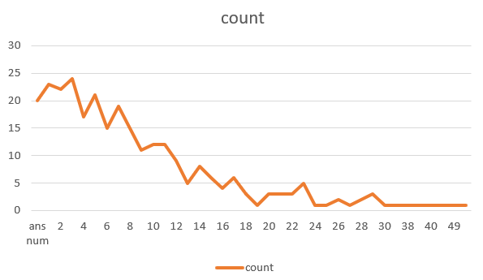
Data Parse
For Target data
Extract data from XML file to build training target list

Slide 4
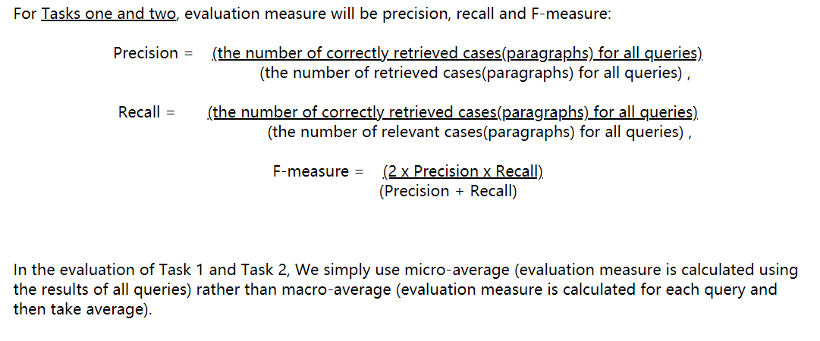
Performance Calculation

Slide 5
Model 1: Association Rule – Baseline Model
Count Vectorizer calculate 2-gram term frequency for target and candidate cases
Calculate intersection and union set length
Ranking Score = intersection length/union length ranking score
Calculate ranking score of target cases and their candidates and sort

Slide 6
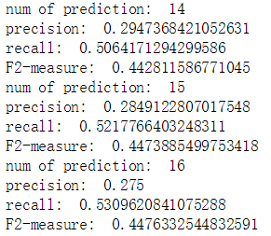
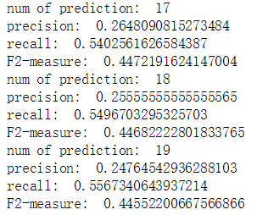
Model 1: Association Rule – Optimized Model
Improvement: remove stop words and high frequency terms (min_df=0,ngram_range=(2,2),max_df = 0.02, stop_words='english')
Calculate ranking score of target cases and their candidates and sort
Best performance:

Slide 7
Model 2: Word2Vec and Random Forest
Gensim Doc2Vec to generate 50 numbers long vectors of target cases and candidate cases. Doc2Vec is trained by all articles in task 1.
Build dataset contain relevant case set with label ‘1’, and randomly picked irrelevant case set with label ‘0’
Utilize random forest to predict the relevance label.(max_depth=50, random_state=0, n_estimators=100)
Apply 70% of the dataset as training data, 30% as testing data
Model performance is not good, the F-2 measure is below 4%

Slide 8
Model 3: Word2Vec and Association Score
Include the Ranking score in Association Rules model as a feature to the previous random forest model
Utilize random forest to predict the relevance label(max_depth=50, random_state=0, n_estimators=100)
Apply 70% of the dataset as training data, 30% as testing data
Model performance has improved by 2 times, the best F-2 measure is around 7%

Slide 9

Result:
The best performance is the association rules model with prediction number of 16.
Applying stop words and high frequency terms can improve accuracy of predicting relevant cases.
Among all attempts, 2-gram terms have the best performance.

